Slide 1
Natural Language Processing
Homework 3:
Chinese Event Extraction

Slide 2
Description
In this homework, you will need to use sequence labeling models for Chinese event extraction.
Event information are defined as two parts:
Trigger: the main word that most clearly expresses the occurrence of an event.
Argument: an entity, temporal expression or value that plays a certain role in the event.
For example:
“因特尔在中国成立了研究中心”
“成立” is the trigger of type Business
“英特尔”, “中国” and “研究中心” are the arguments of type Agent, Place and Org

Slide 3

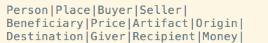
Description
This task is separated as two subtasks:
Trigger labeling: identify the trigger word in the sentence, and classify it to the following 8 types:
Argument labeling: identify all the arguments in the sentence, and classify them to 35 types (some are listed below, all types could be found in the training file):
You are required to implement HMM and use CRF models for this task.
Note that the performance of HMM can be very poor.

Slide 4
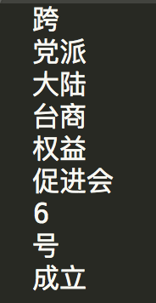
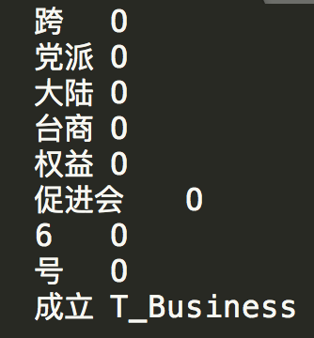
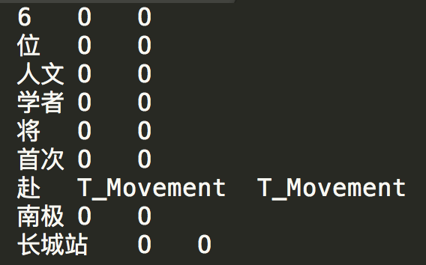
Formal Definition
Input
A sequence of segmented Chinese words.
Output
Label each word with ‘T_type’ (trigger), ‘A_type’ (argument) or ‘O’ (neither trigger nor argument). Save your labeling result after the real label separated with tab.
fg1:input
fg2: training instance
fg3: testing result
Notes:
跑一下CRF++

Slide 5
Provided Files
trigger_train.txt & trigger_test.txt :
These two files contain 1,918 and 669 instances for training and testing, respectively.
Each line contains one word and its label separated by tabs.
Instances are separated by blank line.
argument_train.txt & argument_test.txt :
These two files contain 2,131 and 997 instances for training and testing, respectively.
Your job is to predict the sequence label for instances in test files, and write your predictions in result files. The labels in test files are only for evaluation.
eval.py
This file can help you evaluate your model’s accuracy, precision, recall and F1-score.

Slide 6
Submission
Generate a zip file and name it as “sid_homework-3.zip”.
It should include a python file named “extraction.py”, two output files named “trigger_result.txt” and “argument_result.txt”, and a written report named “chinese event extraction.pdf”.
Program: codes should be written in python.
Report: the report needs to be written in English with no more than 3 pages.

Slide 7
Evaluation
We will mark your homework based on the four criteria:
HMM implementation (30%)
Other Program (20%)
Final accuracy (20%)
Report (30%)

Slide 8
Due
Submit your homework via E-learning system.
Deadline: Mid-night at December 15th 2019
If you have any questions about this homework, please send email to TA or me.
TA：
陈 伟： 18110980003@fudan.edu.cn
王红瑞： 18210180087@fudan.edu.cn

